Slide 1
Unlimited IV
Edubot Kit
Matthew Ariho
Reid Beaulieu
Pranjal Biswas
Jagan Lidder

Slide 2
01
02
03
04
05
06
Introduction
Problem
Design Considerations
System Design
Bill of Materials
Conclusion

Slide 3




Introduction
Pranjal
4th Year MSE Student
Reid
4th Year MSE Student
We are Unlimited IV
Power = (Current x Voltage) = IV
IV = 4 in romal numerals = 4 members
This is the best name you’ve ever heard
Jagan
4th Year MSE Student
Matthew
4th Year MSE Student

Slide 4
Problem
Create a free, open-sourced, programmable, fun and low-cost educational robot kit
Safe and easy to build
Focus on common STEM lessons in K12 schools
Made from off-the-shelf building materials and recycled materials
Programmable
Microcontroller
Sensors and other features

Slide 5
Design Considerations
Reusability of Components
We have chosen to use the Raspberry Pi Pico as our central processor kit
The Pi Pico is an off the shelf hobbyist hardware that can be removed and reused in a multitude of other applications
Our case is designed to be simple and reusable, with the option to 3D print the body as well
Use of Standards
Universal Serial Bus (USB) industry standard compliant
Standard shielding/current limiting circuit for power supply
Prevents current spikes and damage to Pi
Assumptions and Constraints
500mA USB at 5V when in tethered mode
UART functionality with virtual serial port
No additional power into system

Slide 6
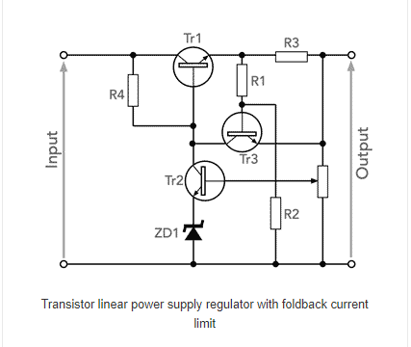
System Design
Chassis Design
Electronic and Software System
Focus on functionality, simplicity and efficiency. The design is modular and robust, with upgradeable parts and a a fully customizable chassis. The grid of mounting holes allows for easy installation of a variety of parts, for beginner and advanced users.
The circuit was built with considerations for the design parameters. We focused on using simple parts, such as wires, and resistors, as well as some basic components like the Pi Pico, an Ultrasonic Sensor and some motors
Drive Design
The bot is designed with two rear wheels and one central free wheel, to reduce the complexity and cost of our design.

Slide 7
Sample Chassis Assembly Process

Slide 8
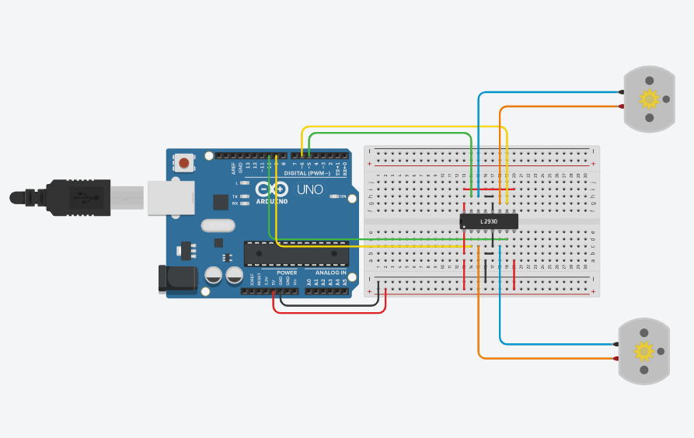
Project A: Building and driving a robot
This project was designed as an introduction to the basic functionality of the robot, specifically;
Interfacing with the controller
Working with motors(speed control)

Slide 9
Project B: Drawing Bot
This project was designed as the next step in the introduction to the basic functionality of the robot, specifically;
Secondary motor control to achieve certain tasks like re-orienting the robot or drawing shapes with the caster

Slide 10
Project C: Generate PWM
This project was designed as the final step in the introduction to the basic functionality of the robot
It takes it a step further by using practical lessons to illustrate concepts like how analog signals are created by the controller or PWM

Slide 11
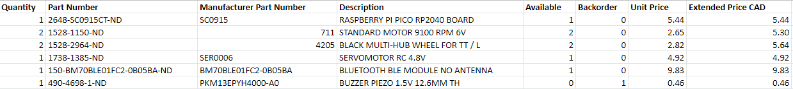
Materials
Total Cost: $31.59
This is the minimum cost for the basic components required for the U4 EduBot
Most of these parts, like the Raspberry Pi Pico are the difficult to outsource or recycle without sacrificing a significant amount of the kit’s overall functionality and modularity.
The design is still built for these components to be user upgradeable for powerful hardware for intense projects.
Some of these components like the Bluetooth module were added to make the bot more user-friendly.
Notes:
Studies have shown students sometimes feel threatened by coding environments so an GUI based application with a bluetooth interface seemed like a good idea

Slide 12
Thank you!
Questions?
Matthew Ariho
Reid Beaulieu
Pranjal Biswas
Jagan Lidder

Slide 13
References
[1] Dejan Nedelkovski, “Arduino DC Motor Control tutorial - L298N | H-bridge | PWM | robot car,” YouTube, 08-Aug-2017. [Online]. Available: https://www.youtube.com/watch?v=I7IFsQ4tQU8&amp;t=200s. [Accessed: 20-Nov-2021].
[2] “Free CAD designs, Files &amp; 3D models: The grabcad community library,” Free CAD Designs, Files &amp; 3D Models | The GrabCAD Community Library. [Online]. Available: https://grabcad.com/library/tt-motor-wheel-yellow-1. [Accessed: 20-Nov-2021].
[3] “Free CAD designs, Files &amp; 3D models: The grabcad community library,” Free CAD Designs, Files &amp; 3D Models | The GrabCAD Community Library. [Online]. Available: https://grabcad.com/library/yellow-dc-motor-1. [Accessed: 20-Nov-2021].
[4] “Free CAD designs, Files &amp; 3D models: The grabcad community library,” Free CAD Designs, Files &amp; 3D Models | The GrabCAD Community Library. [Online]. Available: https://grabcad.com/library/yellow-dc-motor-1. [Accessed: 20-Nov-2021].
[5] “Raspberry pi documentation,” Raspberry Pi. [Online]. Available: https://www.raspberrypi.com/documentation/. [Accessed: 20-Nov-2021].

